Slide 1
Intro to Data Science for Developers with Azure Machine Learning Studio
Gorka Madariaga
Technical Evangelist
@Gk_8 – gorkma@microsoft.com

Slide 2
What is Machine Learning?
Computing systems that become smarter with experience
“Experience” = past data + human input
Notes:
https://studio.azureml.net/
Machine Learning está enfocado en que las máquinas aprendan a realizar tareas de clasificación, predicción y decisión en lugar de que lo hagan humanos. Cuando tienes datos que se duplican cada 18 meses es muy complicado tratar con ellos, pero las máquinas van muy bien cuando tienes que realizer tareas repetitivas con muchos datos. Encontrar patrones, clasificar datos, identificar anomalías.
El reconocimiento de la escritura es un ejemplo muy bueno, pues con las técnicas modernas de ML ya estamos llegando al 90% de precision
Formal definition: “A computer program is said to learn from experience E with respect to some class of tasks T and performance measure P, if its performance at tasks in T, as measured by P, improves with experience E” - Tom M. Mitchell
Another definition: “The goal of machine learning is to program computers to use example data or past experience to solve a given problem.” – Introduction to Machine Learning, 2nd Edition, MIT Press
ML often involves two primary techniques:
Supervised Learning: Finding the mapping between inputs and outputs using correct values to “train” a model
Unsupervised Learning: Finding patterns in the input data (similar to Density Estimates in Statistics)
Azure Machine Learning for Engineers
http://blogs.technet.com/b/machinelearning/archive/2015/06/29/azure-ml-for-engineers.aspx
ML Vocabulary
Experiments are built by data scientists to create and study different algorithms while they determine the best model to solve their current problem.
Model generally refers to a trained model in which an algorithm has been trained to work with a specific set of data around which it can make predictions.
Features are individual and measurable data points that are to be fed into models to perform predictions on.
Labels are historic results associated with a set of features.
Training Data is a pairing of historic Features and historic Labels and is used as a basis to train a model. Note, however, that labels are not always required to create a useful model.
Supervised Learning refers to the training of a model where the Training Data contains both Features and Labels. The way to think about this is we are training the computer to learn on historic outcomes, so it already has an understanding of what it should produce.
Unsupervised Learning refers to the training of a model where the Training Data contains only Features.

Slide 3
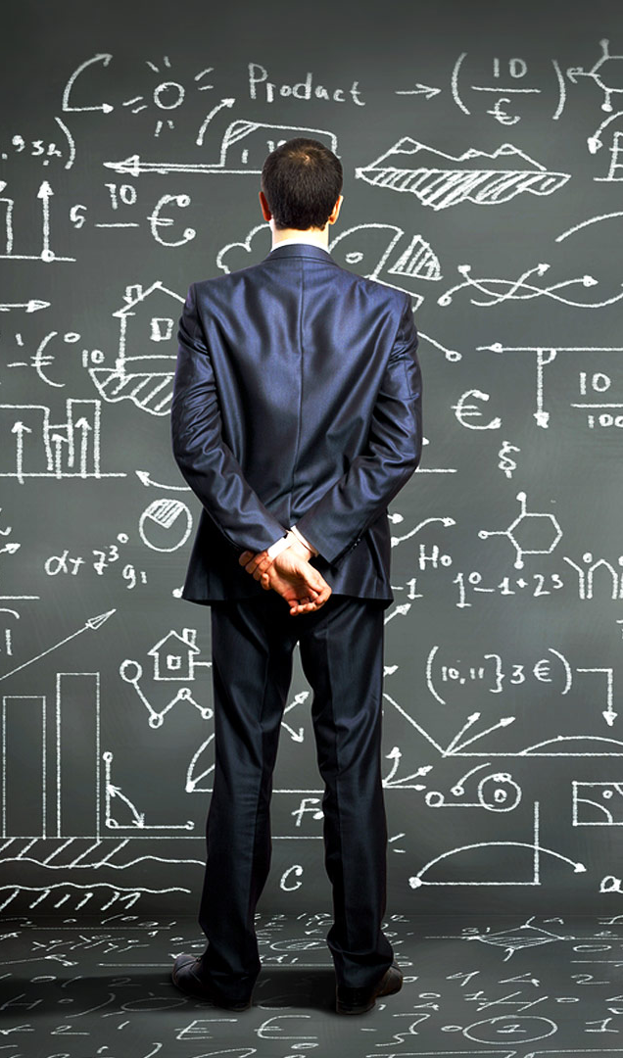


Machine Learning Adoption Challenges
Specialized skills
Infrastructure
Long time to insight
Productization Complexity
Notes:
Skill shortage - 63% of enterprises feel they have a strategic shortage of data scientists, a role that usually requires an advanced degree, mostly in a quantitative field…
Expensive - Huge set-up costs of tools, expertise, and compute/storage capacity create unnecessary barriers to entry
Siloed data - Siloed and cumbersome data management restricts access to data
Disconnected tools - Complex and fragmented tools limit participation in exploring data and building models
Deployment complexity - Complex and fragmented tools limit participation in exploring data and building models

Slide 4
Microsoft & Machine Learning
Answering questions with experience
1991
1997
2008
2009
2010
2014
2014
Microsoft Research formed
Hotmail launches
Which email is junk?
Bing maps launches
What’s the best way home?
Bing search launches
Which searches are most relevant?
Kinect launches
What does that motion “mean”?
Skype Translator launches
What is that person saying?
Azure Machine Learning launches
What will happen next?

Slide 5




What can Azure ML do for you…?
Telemetry data analysis
Buyer propensity models
Social network analysis
Predictive maintenance
Web app optimization
Churn analysis
Natural resource exploration
Weather forecasting
Healthcare outcomes
Fraud detection
Life sciences research
Targeted advertising
Network intrusion detection
Smart meter monitoring
Notes:
http://azure.com/ml
What Types of Questions Can Data Science Answer?
http://blogs.technet.com/b/machinelearning/archive/2015/08/27/what-types-of-questions-can-data-science-answer.aspx

Slide 6
Trained models

Slide 7
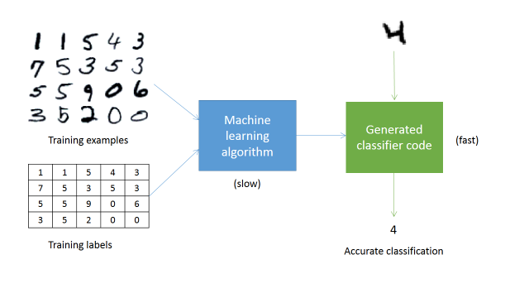
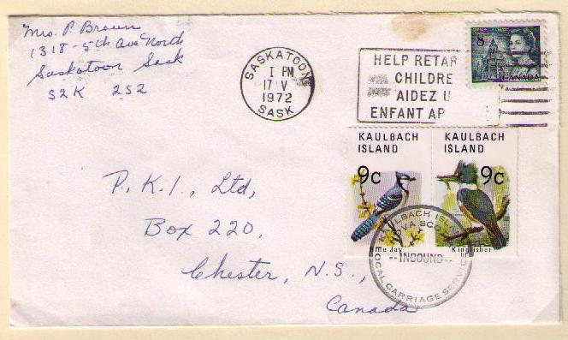
1 | 1 | 5 | 4 | 3
7 | 5 | 3 | 5 | 3
5 | 5 | 9 | 0 | 6
3 | 5 | 2 | 0 | 0
Training Examples
Training Labels
Accurate digit classifier
2
Machine Learning System
Notes:
ML approach: By applying concepts from a range of fields, including statistics, probability theory, and so on, we can build an ML system that “learns” to recognize handwritten digits by being trained on thousands, or even millions, of examples.
So, in order to get an accurate digit classifier, all we need to do is acquire lots of training examples, with labels (this is called “labeled training data”), and then feed it into the ML system.

Slide 8
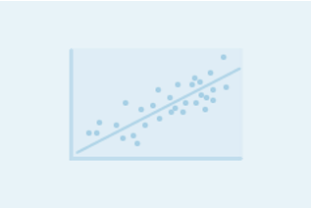
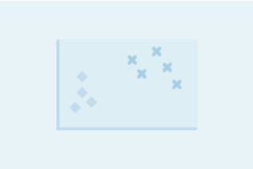
Regression versus Classification
Do you want to…
…predict/estimate a number?
Regression problems
…or apply a label/category?
Classification problems

Slide 9
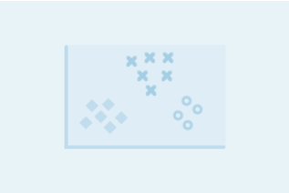
Binary versus Multiclass Classification
Do you want a yes/no answer?
Binary problems
Multiclass problems

Slide 10
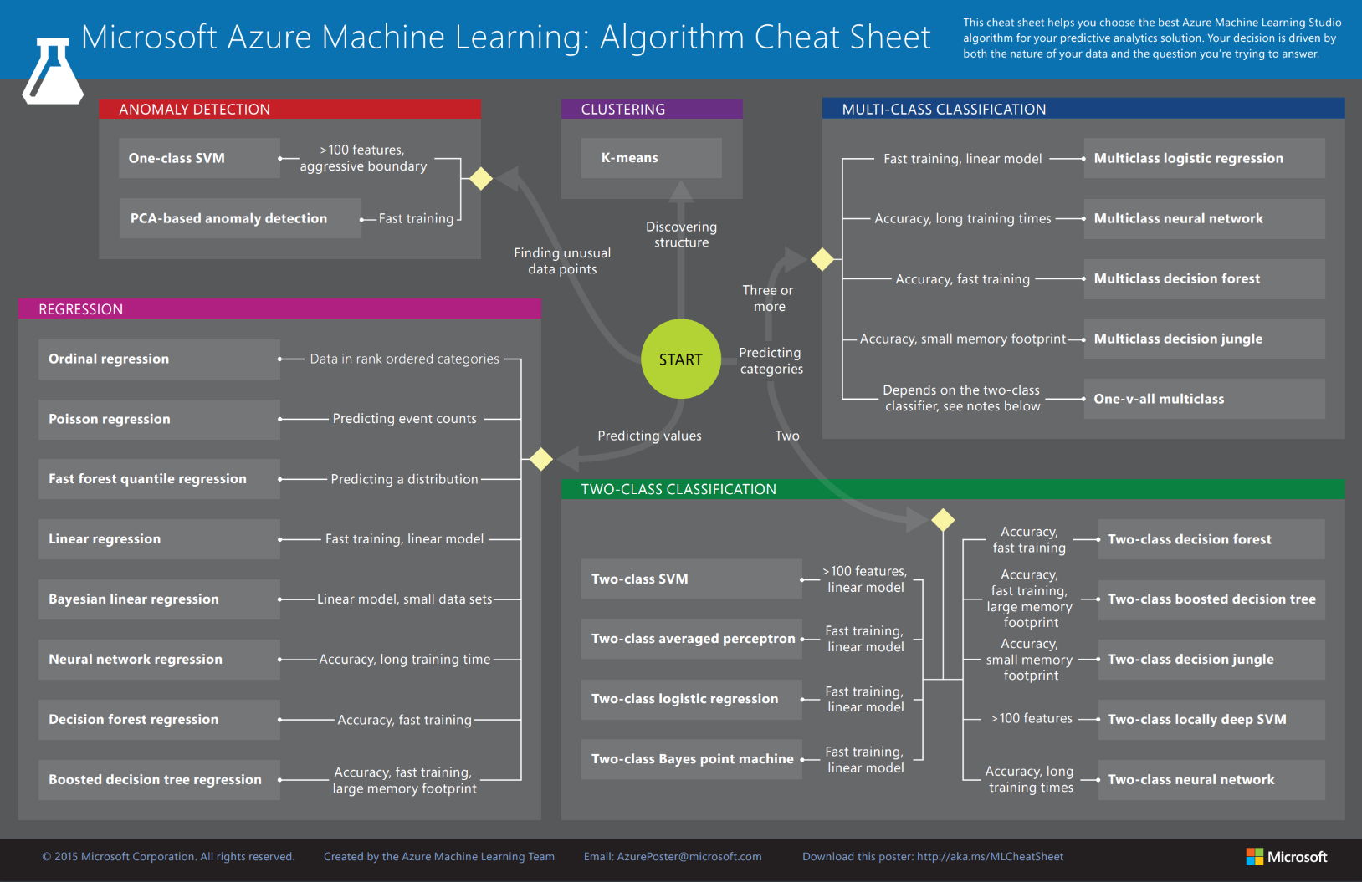

Slide 11
Which algorithm should you pick?
Depends on your problem – what does your data look like?
Logistic regression, support vector machines are good for linear problems
Decision trees are intuitive and easy to interpret
Decision trees naturally handle categorical data, data scaling not required
Support vector machines are effective for high dimensional data
Basic decision trees are not as accurate…
Do what data scientists do…try multiple algorithms and select the best model for your data!
Notes:
Machine learning algorithm cheat sheet for Microsoft Azure Machine Learning Studio
https://azure.microsoft.com/en-us/documentation/articles/machine-learning-algorithm-cheat-sheet/

Slide 12
Lessons learned…
Know your data
80% preparing – 20% analyzing
Try different algorithms/adjustments
It will get better over time!

Slide 13
Thank you! ☺ https://aka.ms/innovation-day-esdx
Gorka Madariaga
@Gk_8
gorkma@microsoft.com

